Slide 1



Brian Sandoval
Governor
Richard Whitley
Director
State of Nevada
Department of Health and Human Services
Division Name
The Crisis Now Model:
Transforming Services is Within Our Reach
Stephanie Woodard, PhD
DHHS Senior Advisor on Behavioral Health
Behavioral Health Commissioner
Helping People. It’s who we are and what we do.

Slide 2
Crisis Now
Crisis mental health care in the United States is inconsistent and inadequate. This is tragic in that good crisis care is a known effective strategy for suicide prevention, a preferred strategy for the person in distress, a key element to reduce psychiatric hospital bed overuse, and crucial to reducing the fragmentation of mental health care.
Notes:
With non-existent or inadequate crisis care, costs go up because of hospital readmissions, overuse of law enforcement, and human tragedies. In too many communities, the “crisis system” has been unofficially handed over to law enforcement, sometimes with devastating outcomes. Our current approach to crisis care is patchwork, delivering minimal care for some people while others (often those who have not been engaged in care) fall through the cracks resulting in multiple readmissions, life in the criminal justice system, or death by suicide.

Slide 3
Statistics
Nearly 10 million individuals in the United States are estimated to live with a diagnosable psychiatric condition sufficiently serious to impair their personal, social, and economic functioning.
Approximately 20% of the population struggles with a mental illness at any time, and suicide is the 2nd leading cause of death for people under age 35.
Nevada’s population has grown by an estimated 10% since 2010.
While mental health utilization has decreased from state-funded facilities, hospital visits to both the emergency department and inpatient admissions have increased since 2009, especially for depression and anxiety.
Between 2009 and 2017, Nevada had its highest age-adjusted suicide rate in 2016, which was 20.6 per 100,000 population while the lowest rate was in 2012, with 17.8 per 100,000 population.
1
3
2
2
2
Notes:
Thousands of Americans dying alone and in desperation from suicide
Unspeakable family pain for those whose children have serious mental illness
Inhuman treatment of individuals who sometimes wait for
days in EDs
The wrong care in the wrong place, compromising other medical urgent care
Tying up valuable law enforcement resources to substitute for viable crisis mental health systems

Slide 4

Suicide Rates
Nevada Age-Adjusted Suicide Rates (Per 100,000)
2010-2017
 | Year | NV All Suicides Rate | National Suicide Rates (CDC)
 | 2010 | 20.3 | 12.1
 | 2011 | 18.7 | 12.3
 | 2012 | 18.4 | 12.6
 | 2013 | 18.9 | 12.6
 | 2014 | 19.6 | 13.0
 | 2015 | 18.8 | 13.3
 | 2016 | 21.2 | 13.4
 | 2017 | 20.4 | --
Notes:
NV versus national statistics/charts.

Slide 5
Crisis Intervention Cost
Service in NAC | Service Description | Billing Code | Provider Type | Rate
Crisis Intervention | Crisis Intervention Services, per 15 minutes | H2011 | -PT 20 (Psychiatrist) -PT 26 (Psychologist) -PT 82, Spec. 300 (Behavioral Health Rehabilitative Treatment- QMHP) | $21.71
 | Crisis Intervention Services, per 15 minutes (team services) | H2011 HT | -PT 20 (Psychiatrist) -PT 26 (Psychologist) -PT 82, Spec. 300 (Behavioral Health Rehabilitative Treatment- QMHP) | $34.22
Notes:
Doing the math, crisis intervention could cost between $86.84 to $136.88 per hour for face to face contact.

Slide 6
The Problem
One Size Fits All
Most communities in the United States build their behavioral health services under the binary assumption that a person needs outpatient or inpatient treatment.
In communities where there is not a sufficient array of crisis services, providers match people with the next available higher service level.
Notes:
This means, if there are not appropriate levels of care in certain communities, then patients may be filtered to the highest levels of care; and/or the emergency rooms causing the emergency room to act as a default crisis service provider.

Slide 7
Preventable Tragedies
Suicide
Family pain
Psychiatric Boarding
The wrong care in the wrong place
Law enforcement working as “mobile crisis”
Notes:
The Treatment Advocacy Center: The consensus opinion of an expert panel on psychiatric care estimated the need as around 50 public beds per 100,000 population. Available 365 days a year.
Psychiatric boarding- Every time a psychiatric boarding occurs, the hospital experiences a cost/loss of $2,264 minimum.
Patients averaged ED times of 72 hours to months; with minimal care/interventions.
In 2014- The Washington State Supreme Court ruled that boarding psychiatric patients temporarily in hospital emergency rooms and acute care centers because there isn’t space at certified psychiatric treatment facilities is unlawful. The court ruled unanimously that patients held temporarily in settings that don’t provide individualized psychiatric treatment violates the state’s Involuntary Treatment Act.
Nami offers CIT training for officers. According to Nami, those trained in CIT reported feeling more competent to work with individuals in crisis. 80% decrease in officer injuries.
In over 2,700 communities nationwide, CIT programs create connections between law enforcement, mental health providers, hospital emergency services and individuals with mental illness and their families. Through collaborative community partnerships and intensive training, CIT improves communication, identifies mental health resources for those in crisis and ensures officer and community safety.

Slide 8
Assessing Level Of Care
1.2 million caller episodes of care were evaluated for higher intensity cases in which emergency department, law enforcement or mobile crisis were involved 54% warranted non-secure sub-acute crisis level of care which is often unavailable in communities.
Notes:
Most likely scenario for people to seek emergency services were individuals in need of non-secure sub-acute care which are also least likely to exist in communities.
This void sends individuals to a higher level of care, in this case an emergency room.
While in the ER, the care an individual receives is not case specific. ER would not necessarily give individuals needed interventions.
If there was an appropriate level of care, this would alleviate pressure on ED if we were able to provide CT’s the most accurate level of care.

Slide 9
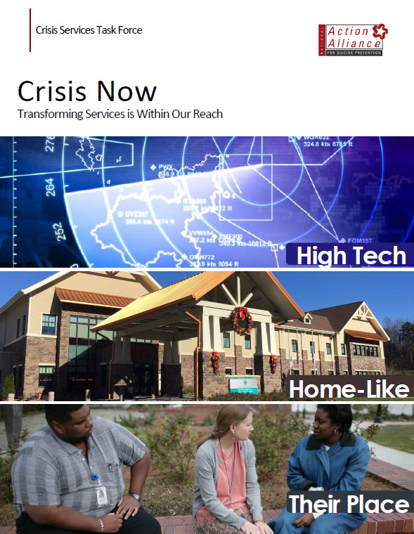
CORE ELEMENTS
High-Tech Crisis Call Centers
24/7 Mobile Crisis
Crisis Stabilization
Essential Principles and Practices

Slide 10
High-Tech Crisis Call Centers
Crisis Call Center Specialists that can coordinate all levels of crisis care.
Specialists can support and stabilize up to 90% of cases.
“Air traffic control center” that dispatches appropriate resources and supporting resources.
Notes:
There are four core elements for transforming crisis services.
Number One: High Tech Crisis Call Centers-These programs use technology for real-time coordination across a system of care and leverage big data for performance improvement and accountability across systems. At the same time, they provide high-touch support to individuals and families in crisis.
Crisis Call center– NV specific information. Rachelle Pallatier– number of calls NV has been able to field to other states
Non adequate funding… fully funded we could manage more successfully while in state. EM’d Rachelle 11/19

Slide 11
Crisis Call Center
Historical Data Summary
 | FY15 | FY16 | FY17 | FY18 | Total
All Contacts (includes hangups) | not available | 65085 | 62915 | 66554 | 194554
Total Crisis Contacts | 41871 | 54947 | 52207 | 55911 | 204936
Location | FY15 | FY16 | FY17 | FY18 | Total
Nevada | 16445 | 13414 | 15902 | 19456 | 65217
National | 25237 | 40744 | 34298 | 32947 | 133226
Unknown | 189 | 789 | 2007 | 3508 | 6493
Total | 41871 | 54947 | 52207 | 55911 | 204936
Resolution | FY15 | FY16 | FY17 | FY18 | Total
De-escalated | 24806 | 34860 | 30942 | 33371 | 123979
Escalated | 571 | 643 | 539 | 761 | 2514
No change | 16494 | 19444 | 20725 | 21779 | 78442
Total | 41871 | 54947 | 52207 | 55911 | 204936
Deployed Alternative Services | FY15 | FY16 | FY17 | FY18 | Total
Welfare Check - All Contacts | 220 | 240 | 436 | 1820 | 2716
Welfare Check - Nevada Only |  |  |  | 1044
Notes:
A total of 17,289 Lifeline calls were initiated in NV from July 1, 2017 – June 30, 2018. 9,908 of those were answered in-state at Crisis Call Center, 4,277 were answered out of state at another National Call Center, and 3,104 were not answered at all (either because they were abandoned – in-state or out-of-state, possibly while waiting in queue at an acd center or for various reasons). These were only Lifeline calls.
Approximately 10,000 other calls for various other things, such as child/elder abuse reporting, substance abuse, rural clinics crisis calls, etc., were taken by the Crisis Call Center during the year. Those do not roll out to another center, but are given the opportunity to leave a voice mail if we are too busy. Many times these callers do not leave a voice mail, and we can’t be sure that they get the help they need.
21 employees on the Call Lines (3 of these are supervisors). Of these 21 employees, only 6 (include 3 supervisors are full-time employees), meaning 15 are part-time with various configuration of hours. They do not have the resources to pay for more full-time staff (benefited), so that really effects ability to retain employees.
As for volunteers on the Call Line are approximately 20 at any given time. These volunteers usually come in for 4 hour shifts a couple of times per month.

Slide 12
Crisis Call Center
FY18 Data Summary | Total | % of contacts
All Contacts (Including repeat and hangups) | 66554
Crisis Contacts | 55911
Text Messages | 11407 | 20.40%
Sexual assault survivors helped | 450
Issues | Total | % of contacts
Abuse / Violence / Crime (VOCA) | 21692 | 38.80%
Child Abuse | 17688 | 31.64%
Elder Abuse | 1050 | 1.88%
Addictions / Substances | 8234 | 14.73% | Nevada only contacts: 3418
Basic Needs / Unmet Needs | 4736 | 8.47%
Physical and Mental Health | 23262 | 41.61%
Relationships / Family / Stressors | 26018 | 46.53%
Suicide/Suicide About Another/Survivor of Suicide Loss | 10707 | 19.15%

Slide 13
24/7 Mobile Crisis
Mobile crisis teams meeting people where they are resolving the crisis right then.
Dispatched by crisis call center hub, alleviates law enforcement resources.
Reducing stigma surrounding law enforcement knocking on doors.
Notes:
Mobile crisis offers outreach and support where people in crisis are. Programs should include contractually required response times and medical backup.
CCBHC’s are required to provide 24-hr crisis care including mobile crisis and stabilization.

Slide 14
Crisis Stabilization Programs
Short term “sub acute” care for individual who need support and observation but not an emergency room.
Operate 24/7
Law enforcement drop off time is no more than 5-7 minutes.
Living room model to be more warm and welcoming.
Notes:
No Call. No Referral. No Rejection. Makes it simple.
These programs offer short-term “sub-acute” care for individuals who need support and observation, but not ED holds or medical inpatient stay, at lower costs and without the overhead of hospital-based acute care.
CCBHC provide this… move away from “a bed” in regards to crisis care. Living room model.
Living room model… more warm and welcoming.
Counties and communities need to be clear on what they would like to resolve. Community needs matching services provided. For example, CPC withdrawal mgt, detox services, interventions for people who are suicidal.

Slide 15

Essential Crisis Care Principles and Practices.
Must include:
Recovery Orientation
Trauma-informed care
Significant use of peer staff
Commitment to Zero Suicide/Suicide Safer Care
Strong commitments to safety for consumers/staff, and
Collaboration with Law Enforcement.

Slide 16
Zero Suicide
Shift from fragmented suicide care toward a holistic and comprehensive approach to patient safety and quality improvement within healthcare systems.
Lead system-wide culture change committed to reducing suicides
Train a competent, confident and caring workforce
Identify patients with suicide risk with comprehensive screenings
Engage all individuals at-risk of suicide with a suicide care management plan
Treat suicidal thoughts and behaviors using evidenced based treatments
Transition individuals through care with warm-handoffs and supportive contacts
Improve policies and procedures through continuous quality improvement
Notes:
Core tenants of zero suicide

Slide 17
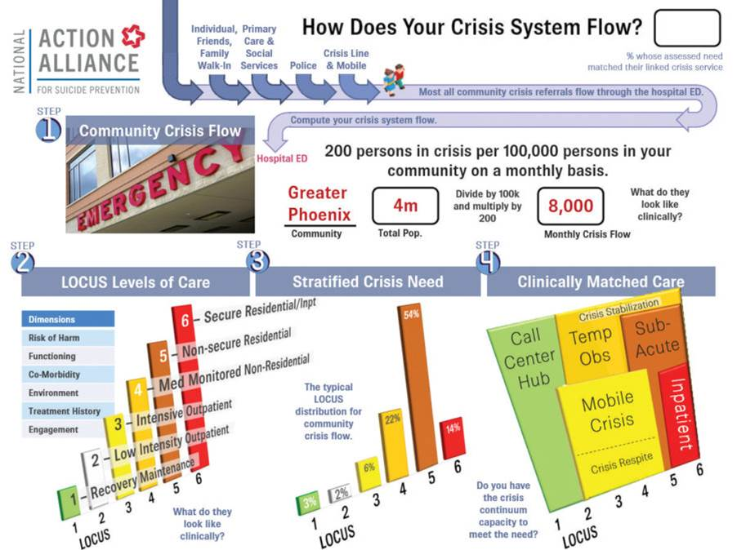
Crisis Now
Notes:
The flow chart.
Permission from RI International

Slide 18
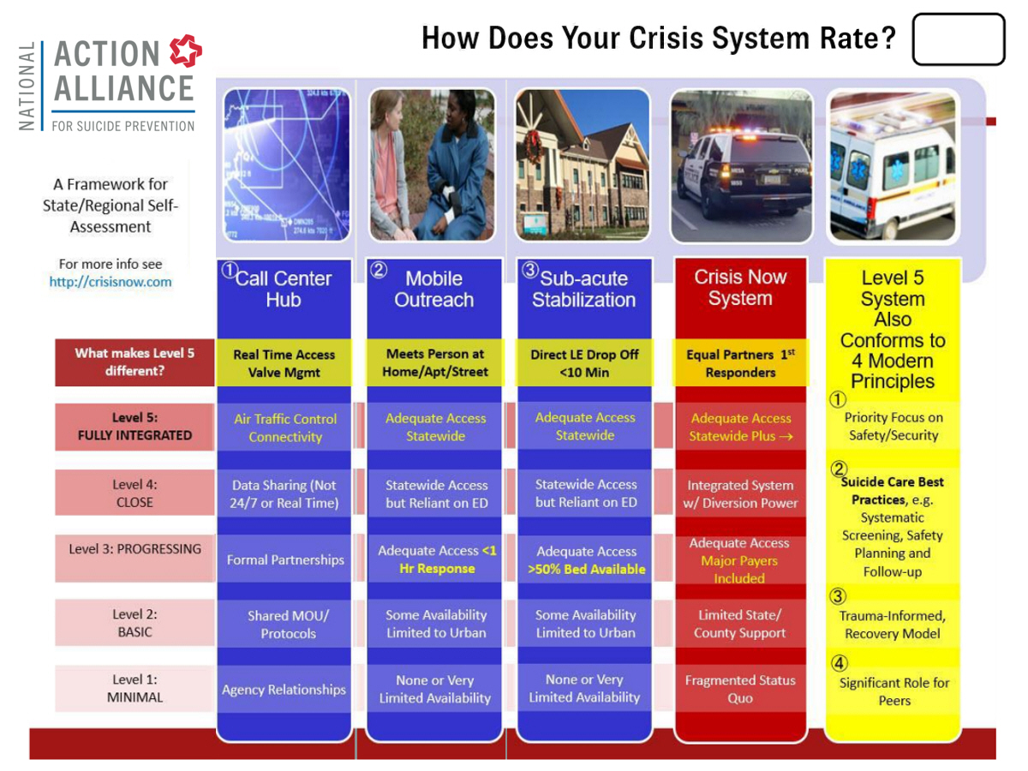
Crisis Now
Notes:
Permission from RI International

Slide 19
Making the Business Case
Based on 4-million person community of Maricopa County (Phoenix, Arizona)
37 FTE Police Officers Engaged in Public Safety instead of Mental Health Transportation/Security
(Resource savings for fire fighters also exist but are not yet quantified.)
Notes:
CIT

Slide 20
Making the Business Case
Based on 4-million person community of Maricopa County (Phoenix, Arizona)
Reduction of 45 Cumulative Years of Psychiatric Boarding (aka waiting in the ED)
Creating a saving to hospitals of $37 million in avoided cost/losses.

Slide 21
Making the Business Case
Based on 4-million person community of Maricopa County (Phoenix, Arizona)
Reduced Potential State Acute Care Inpatient Expense by $260 million.
The cost avoidance represents the net savings of $100 million investment in a full, integrated crisis continuum.

Slide 22
Conclusion
Individuals in a mental health crisis benefit when their communities have a fully developed continuum of crisis services. The Crisis Now Model plays a critical role in a healthy crisis continuum, and their continued sustainability brings hope for the future to any individual suffering with mental illness.

Slide 23
Questions
?????

Slide 24
References
National Action Alliance for Suicide Prevention: Crisis Services Task Force. (2016). Crisis now: Transforming services is within our reach. Washington, DC: Education Development Center, Inc.
https://theactionalliance.org/sites/default/files/crisisnow.pdf
https://www.cbsnews.com/news/virginia-sen-recounts-mentally-ill-son-attacking-him/
https://davidwcovington.com/2014/02/06/air-traffic-control/
State of Nevada Epidemiology Reports
NASMHPD: National Association of State Mental Health Program Director
http://bhltest2.com/#the_video
http://bhltest2.com/wp-content/uploads/2018/05/CrisisNow-BusinessCase.pdf
http://bhltest2.com/wp-content/uploads/2018/05/TACPaper1-BeyondBeds.pdf
http://crisisnow.com/the
Washoe County Regional Medical Examiner’s Office - 2016 Data on Suicides in Northern Nevada
American Association of Suicidology- http://www.suicidology.org/resources/facts-statistics
American Foundation for Suicide Prevention- afsp.org
Office of Suicide Prevention, Department of Health and Human Services, Office of Analytics
Nevada Crisis Call Center

Slide 25
Contact Information
Stephanie Woodard, Psy.D
swoodard@health.nv.gov

