Slide 1
Food Insecurity in Washoe County
Governor’s Council on Food Security
May 17, 2017
Cherie Jamason
Food Bank of Northern Nevada
Melanie Flores, MSW
Washoe County Health District

Slide 2
Outcomes
Understand food security efforts in Washoe County
Understand how Truckee Meadows Healthy Communities (TMHC), Collaborating for Communities (C4C) and the Washoe County Community Health Improvement Plan (CHIP) all work together
Understand root causes of food insecurity
Understand how the Governor’s Council on Food Security can help

Slide 3
Food Security
Access to enough food to live an active and healthy life.
Food Insecure
In Washoe County
Nearly 1/3 of people do not qualify for federal food programs
92% of people who obtain food through food assistance programs cope with personal food shortages by purchasing inexpensive, unhealthy food.
(Map the Meal Gap, 2014)
Population | Washoe County | Nevada
Total Population | 13.7% | 14.9%
Children | 23.8% | 24.3%
Notes:
This priority was led by 5 community partners
To make movement on 10 strategies and
6 Performance measures

Slide 4
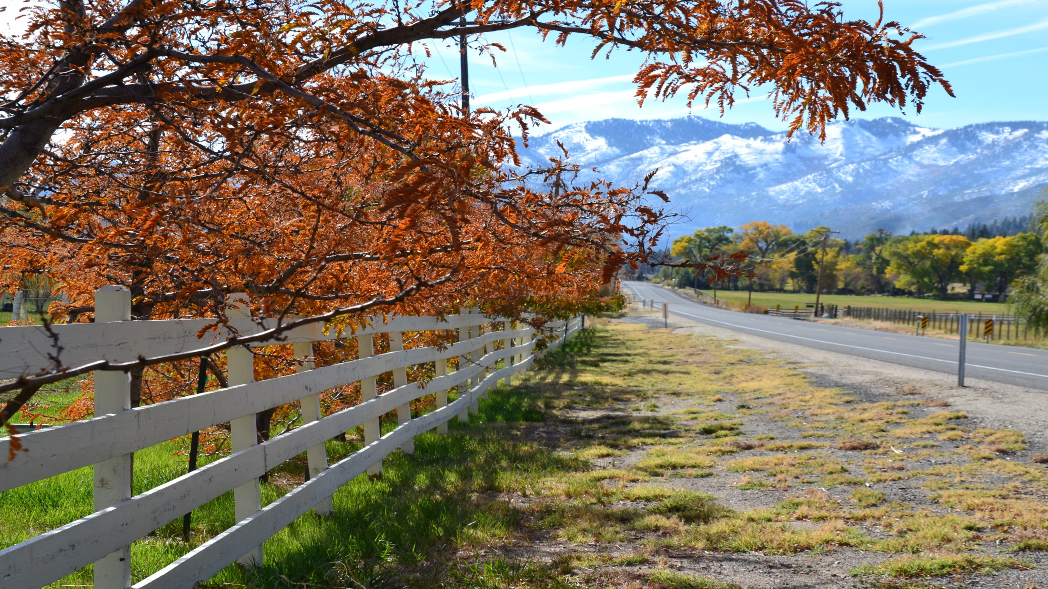
Our Community Approach
Notes:
This priority was led by 5 community partners
To make movement on 10 strategies and
6 Performance measures

Slide 5
The Promise of Working Together On Complex Issues
Structured and Intentional Community Process
Isolated Impact
Collective Impact
Notes:
Our typical way (old) of working is that:
Funders (feds, states, foundations) often select individual grantees and fund programs addressing small portions of complex problems
• State agencies and other organizations often work separately and compete
• Evaluation attempts to isolate a particular organization’s impact
• Large scale change is assumed to depend on scaling organizations
• Private and government sectors are often disconnected Isolated Impact
Source: Channeling Change: Making Collective Impact Work, 2012; FSG Interviews and Analysis.
In Collective Impact we commit across sectors to a common agenda to solve a specific issue.

Slide 6
Principles for Collective Impact
Common Agenda
Common understanding of the problem
Shared vision for change
Shared Measurement
Collecting data and measuring results
Focus on performance management
Mutually Reinforcing Activities
Differentiated approaches
Willingness to adapt individual activities
Continuous Communication
Backbone Support
Shared accountability
Coordination through joint plan of action
Consistent and open communication
Focus on building trust
Separate organization(s) with staff
Resources and skills to convene and coordinate participating organizations
Source: FSG – www.fsg.org

Slide 7
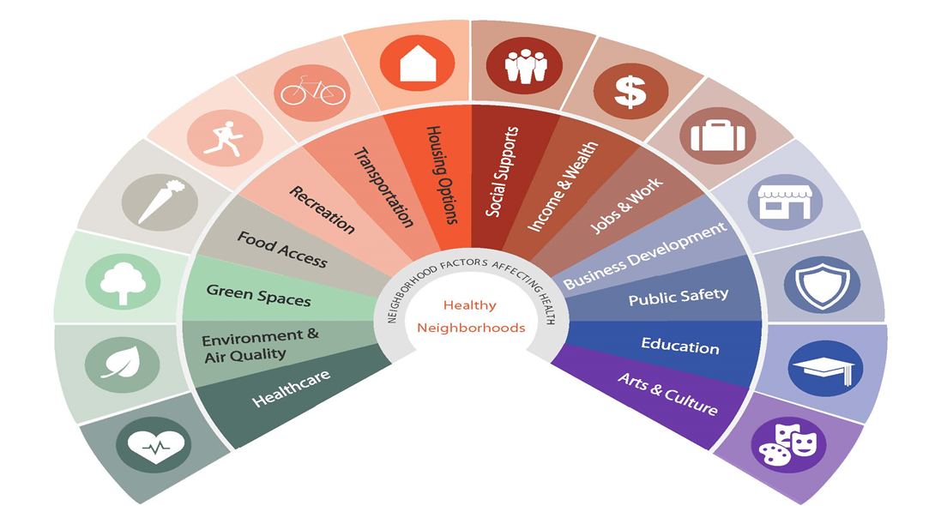
Healthy Neighborhoods Approach
Leading Organization
Backbone Support
Backbone Support
Community Health Improvement Plan
Collaborating for Communities (C4C)
Infographic adapted from the East Bay Asian Local Development Corporation

Slide 8
Washoe County Community Health Improvement Plan

Slide 9
Washoe County Community Health Improvement Plan Overview
Framework and plan of action
Community Health Needs Assessment Data
99 community member interviews, 34 partner surveys, 20 key informant interviews, and 9 community workgroups
Backbone support to community working groups
4 priorities, 9 goals, 55 strategies, 66 objectives

Slide 10
Washoe County
Health Priorities 2016-2018
Access to Healthcare and Social Services
Education
(K-12)
Food Security
Behavioral Health
❶
❷
❸
❹

Slide 11
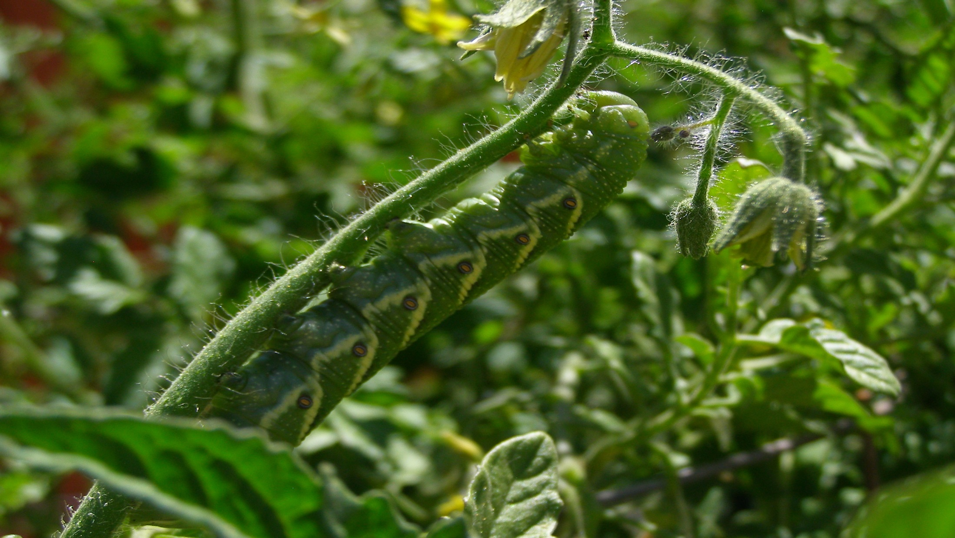
Food Security
Notes:
This priority was led by 5 community partners
To make movement on 10 strategies and
6 Performance measures

Slide 12
GOAL 8: Implement programs that address the immediate need for food and promote long-term health and food security
GOAL 9: Enhance home-delivered meal programs to seniors
Notes:
In the first year of this three year plan, 17% of the objectives and 30% of the strategies met or exceeded their targets
This might be the most developmental of the four priorities
There are a couple reasons that we have some progress noted as red
The community decided to go in a different direction in regards to creating a community gardening plan to expand the scope to a greater food system sustainability plan and aligning efforts of all sectors of food sustainability in the region
Many of the strategies are tied up with the Collaborating for Communities (C4C) Community Action Networks

Slide 13
$516,000 awarded to the Food Bank of Northern Nevada to support “solving hunger” planning for Truckee Meadows Healthy Communities
Food Security Activities
Collaborating for Communities Community Action Networks (C4C, CANs)
Washoe County Food Policy Council
Washoe County Senior Services
A planning grant to test cross-sector, collective impact to address food insecurity through social determinants of health such as affordable housing and economic stability
● Local food system sustainability plan with an emphasis on food access and nutrition
● Developing policy briefs to educate the community on barriers to food access
Reducing the gap in the number of meals served to seniors

Slide 14
Collaborating for Communities
Community Action Networks

Slide 15
Arnold Foundation Planning Grant
Awarded in July 2015 by the Laura and John Arnold Foundation. $380,000 plus $136,000 community match.
3-year pay-for-performance planning grant focused on solving hunger/shortening the lines for food assistance
Goals are to improve the health of residents in the 89502 zip code by creating sustainable change in the community around population health, food security, affordable housing and economic stability
Nevada was one of five state awarded

Slide 16
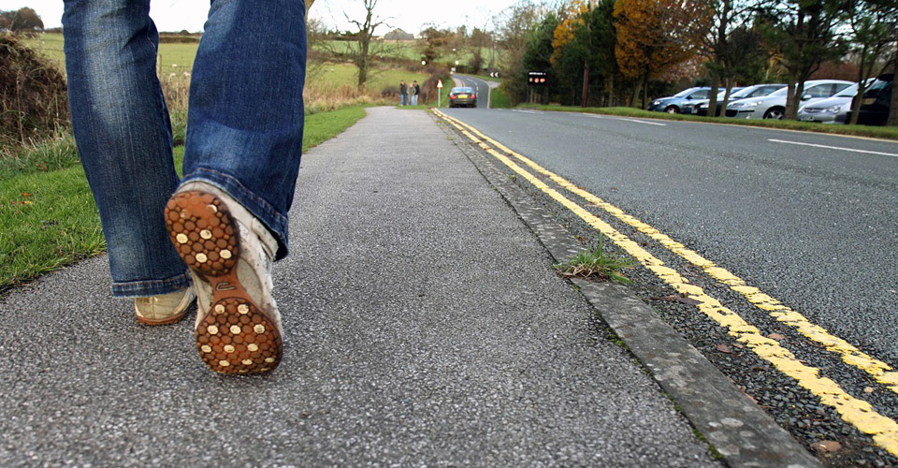
C4C CANs
Engages diverse stakeholders to collectively shape a healthier community
Food Security
Economic Stability
Housing
FEED Leadership Team
Notes:
This priority was led by 5 community partners
To make movement on 10 strategies and
6 Performance measures

Slide 17
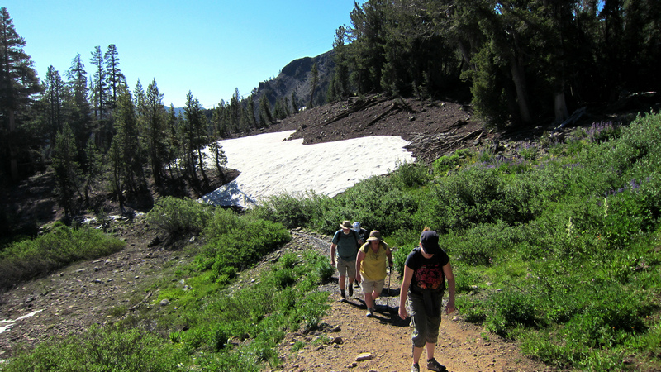
FEED TEAM
All children 0-24 and families identified as CIT live in homes that are safe, affordable, and decent
Strategies
Establish a Community Land Trust for cost burdened families
Engagement and outreach
Rehabilitate, weatherize, improve conditions of housing
Establish permanent supportive housing

Slide 18
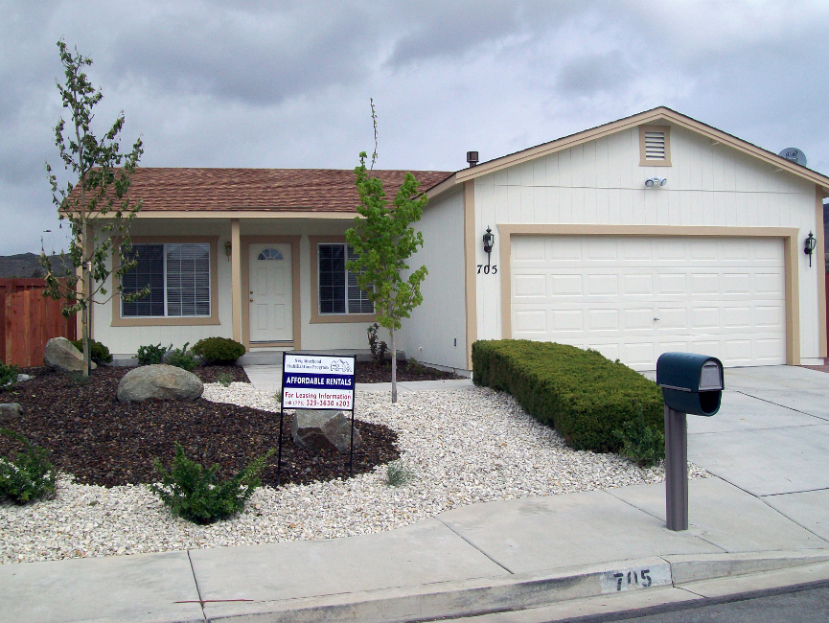
Housing CAN
People live in neighborhoods that provide safe, affordable and decent permanent housing
Strategies
Assist with education legal support and advocacy related to fair housing
Expand individual/community resources
Improve supply, affordability and stability of housing (e.g. rent control, safe multi-family policy)
Improve affordability and condition of housing

Slide 19
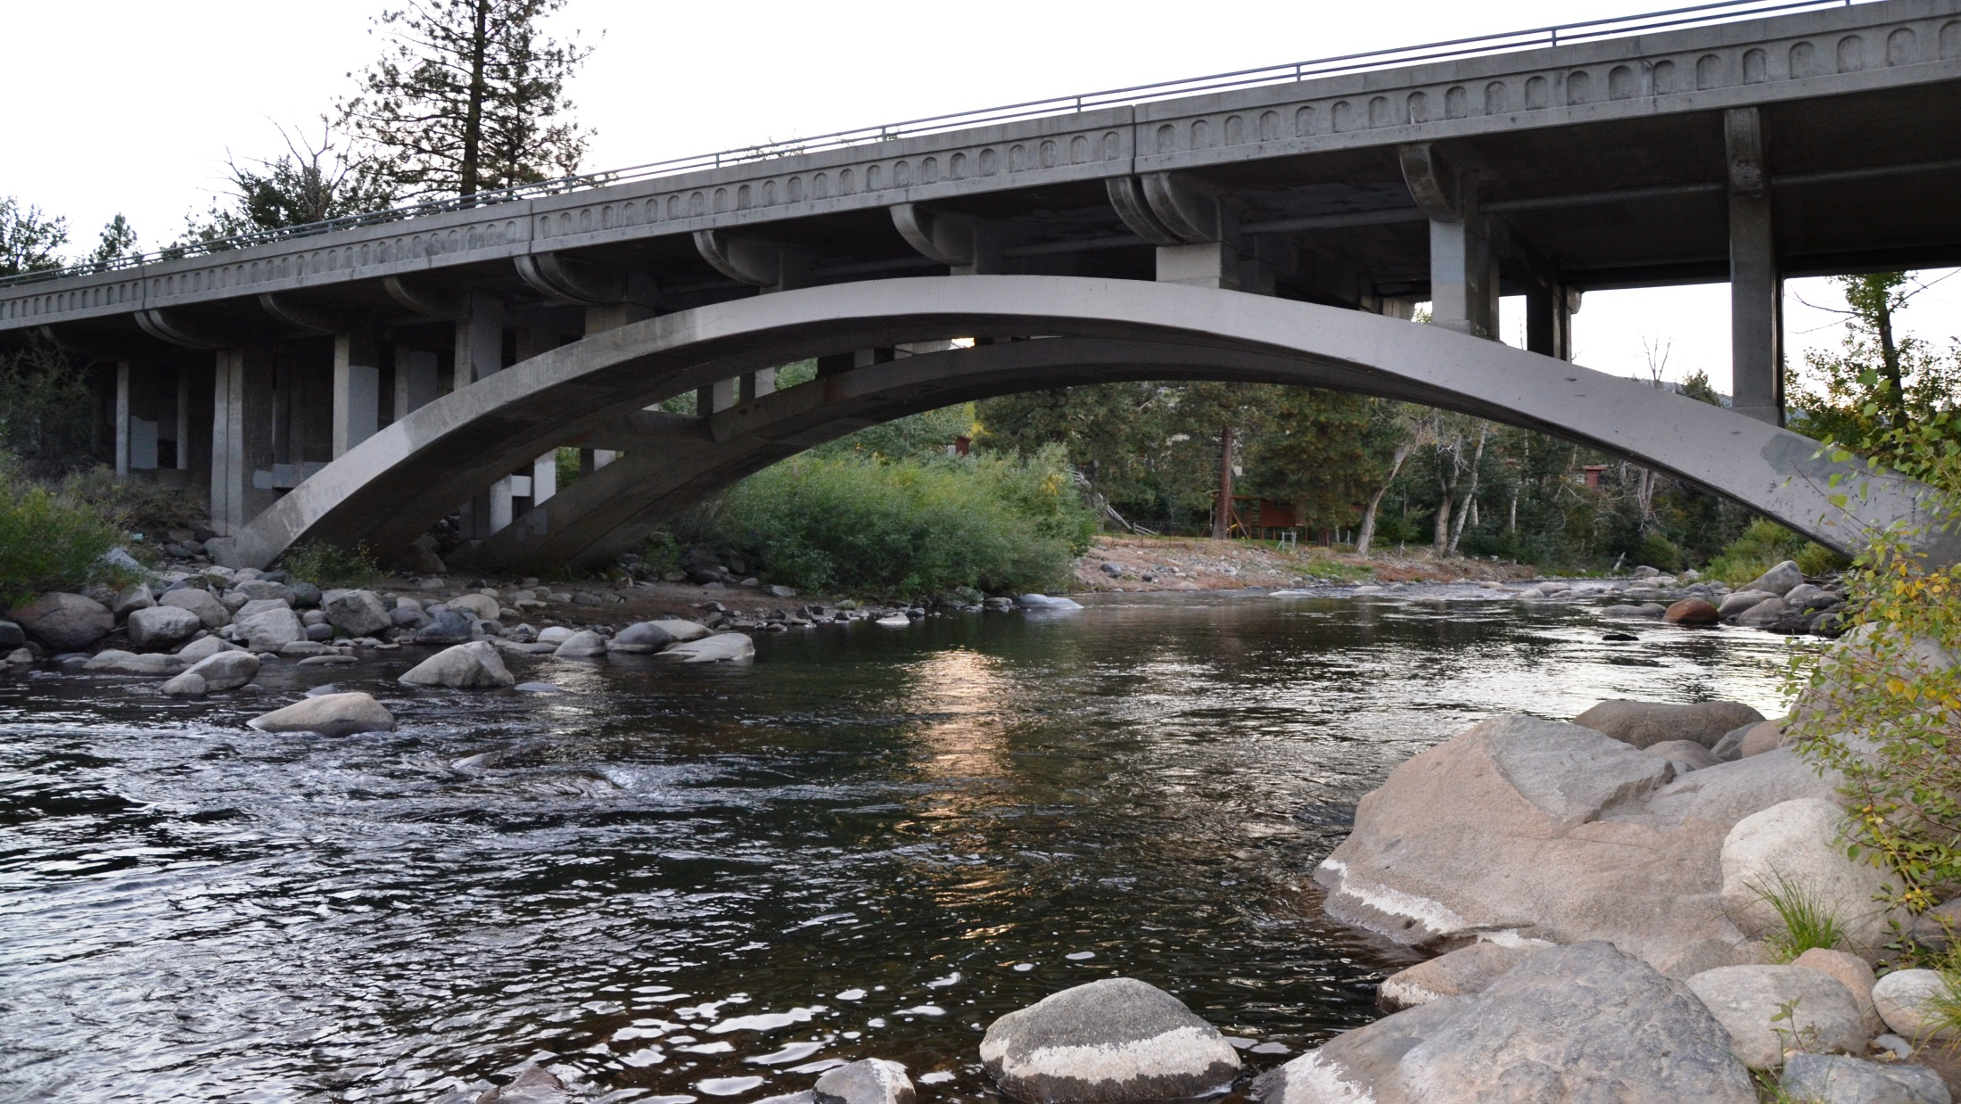
Economic Stability CAN
Households have economic health and people are on pathways to prosperity in 89502
Strategies
Provide training and supports for unemployed families
Assist families to establish savings for emergencies
Support literacy and education supports
Qualify children for Nevada College Savings Plans

Slide 20
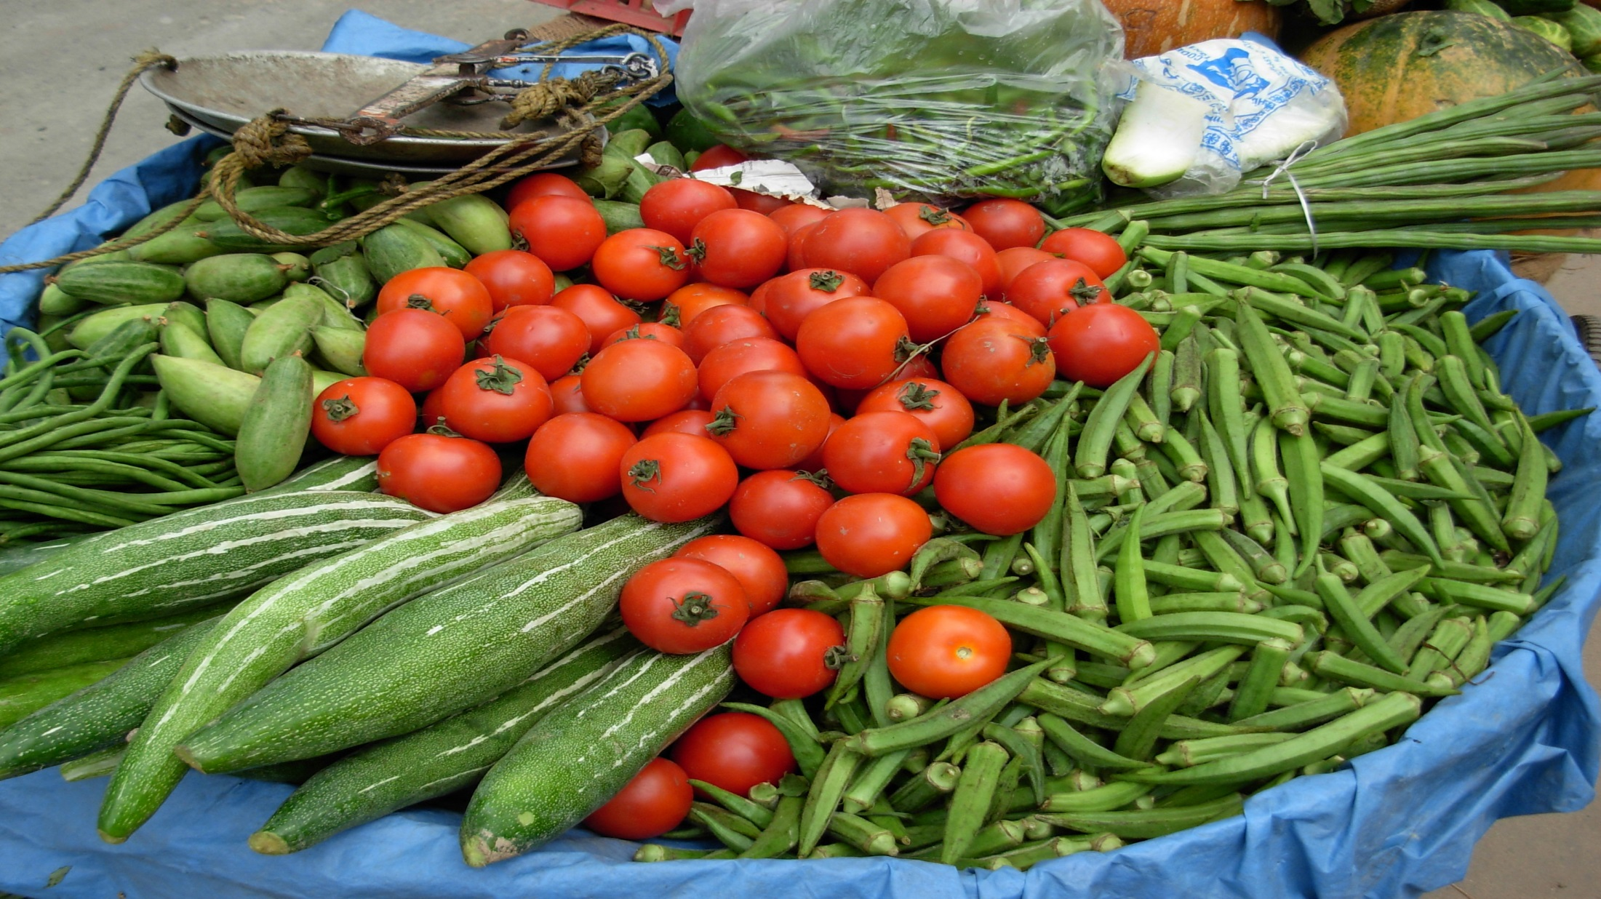
Food Security
CAN
People access and eat nutritious food that promotes long-term health
Strategies
Improve and support screenings of social determinants of health (e.g. food security) through hospitals and FQHCs.
Support comprehensive nutrition education
Improve policies that reduce barriers to food access and nutrition
Increase utilization of food assistance programs (e.g. WIC, SNAP, Food Pantries)

Slide 21
Cross-Sector Approach with a Common Agenda
Non-Profits
Public Health
Health Care
Government
Housing
Banking
Education
Business
Faith Orgs.
Workforce Dvt.
Long-Term Outcomes*
Family Stability
Food Security
Health
Housing Stability
Structured and Intentional Community Process
Income
Education
Notes:
There is excellent work being done in our community; however, working in silos has not done much to move the needle on community wide issues. It must be done with many stakeholder’s at the table.
Cross sector partnerships are critical to help solve community wide issues.
No one organization can create a healthy community. It takes the collaboration of a diverse group of stakeholders working together doing what they do best in a way that supports the ultimate goal to create significant and sustainable change. These are called cross-sector partnerships.
The TMHC Steering Committee and subcommittees have many sectors at the table working in a very deliberate way towards a common goal.
At this stage with TMHC, it is not about creating new programs. It is about identifying and using existing programs and resources as building blocks and aligning multiple sectors and programs so we can work together to reach the vision.

Slide 22
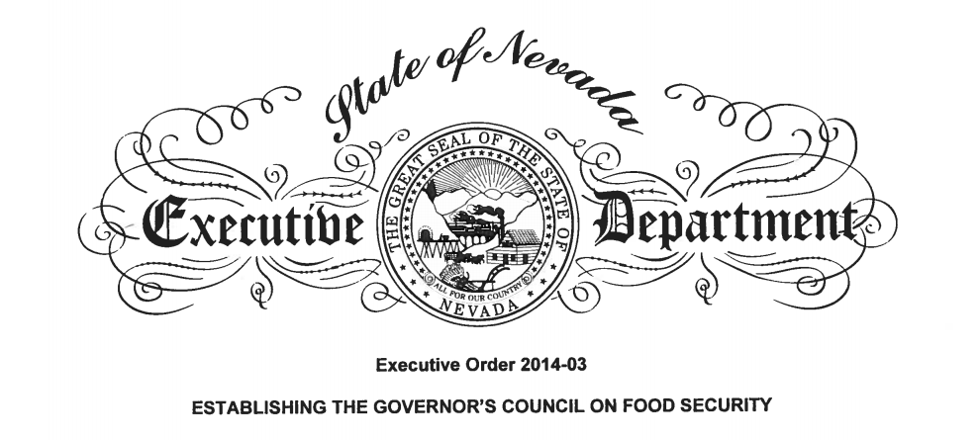
Governor’s Council on Food Security
A Role to Help Washoe County and Pilot Strategies for the State

Slide 23
Mutually Reinforcing Activities
C4C CAN Strategy | Governor’s Council Strategy
Strategy 1 Leverage existing data collection opportunities to understand the burden of food security for Booth and Veterans families.
Strategy 2 Hold focus groups with families in select schools to identify risks, barriers and needs for food security
Strategy 3 Increase food pantry and WIC & SNAP utilization at Booth, Veterans and for eligible families | 2.1.1 Feed more children through increased participation in in-school meal programs and establish accountability measures 2.2.4 Create a strategic partnership between WIC and SNAP to maximize caseloads
Strategy 4 Improve Kids Café to allow parents to eat with their children | 1.2.3 Research and develop a menu of model policies/regulations options to promote food security in Nevada
Strategy 5 Develop best practice screening and referral protocols for food security | 1.2.3 Research and develop a menu of model policies/regulations options to promote food security in Nevada
Strategy 6 Support comprehensive Nutrition Education | 2.1.1 Feed more children through increased participation in in-school meal programs and establish accountability measures
Strategy 7 Promote, educate/raise awareness, partner and support others to encourage multi-family properties, parks and open spaces to allow common gardens, community accessible gardens. | 1.2.3 Research and develop a menu of model policies/regulations options to promote food security in Nevada
Strategy 8 Supporting access to healthy food options | 1.2.3 Research and develop a menu of model policies/regulations options to promote food security in Nevada

Slide 24
Our Ask as a Community
Discuss, include our feedback, and make recommendations to/on:
Including all food assistance program utilization in the State Food Security assessment (statewide and by county)
Provide best practice solutions to coordinate SNAP and WIC
Provide toolkits on food security screening and referral protocols in health care centers and for community based organizations
Produce an annual report to the Governor specifying policy recommendations on how to remove barriers to food access

Slide 25
Contact
Cherie Jamason
President and CEO
Food Bank of Northern Nevada
cjamason@fbnn.org
(775) 331-3663
Melanie Flores, MSW
CHIP Program Coordinator
Office of the District Health Officer
Washoe County Health District
mflores@washoecounty.us
(775) 328-2404

