Slide 1
SUMMER FOOD SERVICE PROGRAM
Governor’s Council on Food Security
April 28, 2015

Slide 3
HISTORY
2015 marks the 40th anniversary of the federally funded Summer Food Service Program.
The SFSP was created to “fill the gap” by providing meals to needy children during summer vacation.
For many children school breakfast and school lunch are the only meals that they eat during the day.

Slide 4
Open Park Site
Food Bank of Northern Nevada

Slide 5
NEVADA
SFSP in Nevada has not kept up with the huge increase in population.
The biggest gap is in Clark County where the number of children qualifying for free and reduced price meals continues to grow with over 58% (186,717) of the Clark County School District enrollment eligible for free and reduced price meals in 2014-15.
Northern Nevada still has room to increase meal sites and participation but the gap is not as wide.

Slide 7
CHALLENGES
In order to increase participation, the following are needed:
more sponsors
more sites
more extensive outreach (media and school
districts)
support/endorsement from elected officials
collaboration with community partners

Slide 8
ADDRESSING THE CHALLENGES
USDA State Targeted Assistance Project
Started in FY13 to assist states in expanding
their SFSP
Nevada joined the project in FY14
USDA provided a technical assistance team to assist states in increasing participation by increasing the number of sponsors and meal sites

Slide 9
2014 Technical Assistance
Formed statewide SFSP partner group – invited local governments, SFSP sponsors, USDA Rural development, state and local elected officials, school district representatives, advocacy groups
Wrote and implemented a Nevada State Summer Meal Plan
USDA representatives contacted state and local elected officials to encourage support of SFSP

Slide 10
USDA Undersecretary Kevin Concannon attend SFSP kick-off event in Las Vegas
USDA provided contact information for possible partners: HUD; Farm Service Agency; Let’s Move Cities, Towns and Counties and more
USDA WRO communications office provide assistance with press releases.

Slide 11
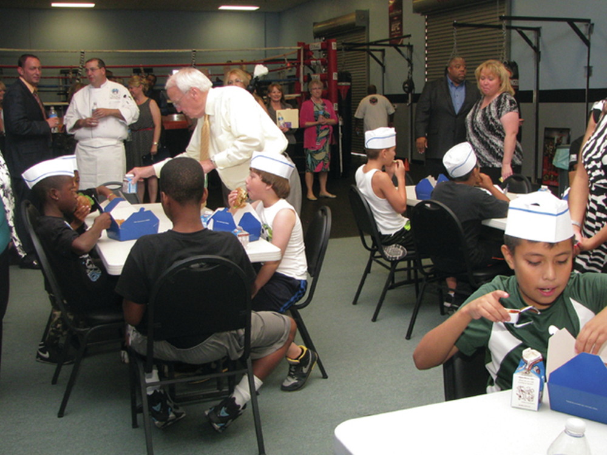

Slide 12
WHERE DO WE GO FROM HERE
2015 SFSP Partner Group – met in January
Nevada State Summer Meals Plan has been revised and updated with new goals
Continue to receive assistance from USDA to increase participation
Reaching out to school districts, tribes, and faith based organizations
Working with established sponsors to increase participation by adding more meal sites and expanding outreach

Slide 13
We can never do too much. As long as there are hungry children, there will be a need for the Summer Food Service Program.
USDA national participation goal for 2015:
200 Million meals (7.5% increase)
NEVADA 2015 PARTICIPATION GOAL: 56,OOO
(10% INCREASE)

Slide 14
For more information, contact:
Karen Vogel, RD, SNS
Nutrition Programs Professional
Nevada Department of Agriculture
Ph: 702-668-4581
kvogel@agri.nv.gov

