Slide 1
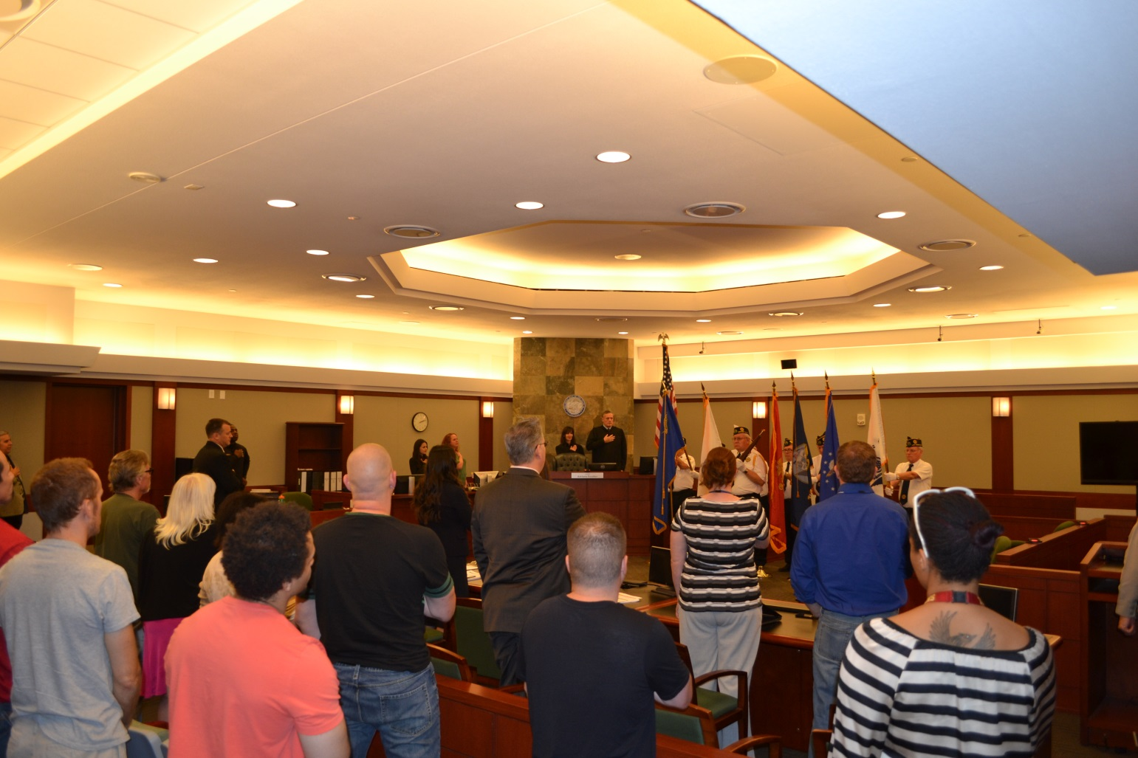
Eighth Judicial District Specialty Court Programs
Serving 1200 – 1500
Clark County Residents Annually

Slide 2
Specialty Court Programs
Substance Abuse Treatment/Co-Occurring
Adult Drug Court
Felony DUI
Juvenile Drug Court
Dependency Mother’s Drug Court
Family Treatment Court [DFS Involvement]
Child Support Treatment Court
Veteran’s Court
OPEN Court
Mental Health Court
1993 Nevada became one of the first states to authorize Specialty Courts/Drug Courts

Slide 3
Purpose of Drug Court Programs
Improves Public Safety
Reduces Criminal Recidivism
Improves Quality of Lives
Saves Money
Less expensive than detention
Reduces criminal justice costs
Increases productivity of participants

Slide 4
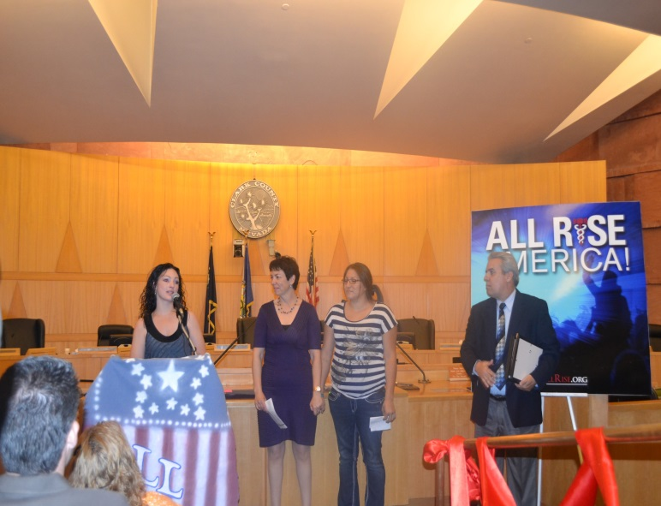
Benefits of Specialty Courts
Provides Treatment
Substance Abuse Counseling
Mental Health Counseling
Case Management Services
Probation Supervision (GM/Felony)
Drug Testing
Medication Management (MHC)
Medically Assisted Treatment
Regular Court Reviews
Without judicial oversight, 70% of substance abusing offenders drop out of treatment.

Slide 5
Eligibility Criteria
Adult Drug Court:
Involved in criminal justice system
Identified alcohol/substance abuse disorder
Non-violent criminal history
No drug trafficking
Felony DUI Court:
Identified alcohol/substance abuse disorder
Non-violent criminal history
No drug trafficking
Three felony DUI charges within 7 years w/no prior felony DUI convictions;

Slide 6
Prescription Drug Use in Specialty Courts
Adult Drug Court:
15% Prescription Drug Users
Oxy
Lortab
Xanax
Percocet
Primary Use
6/10 Methamphetamine
2/10 Heroin
1/10 Prescription Drug
1/10 Marijuana
95% Polysubstance Users
9/10 Methamphetamine
6/10 Heroine
1+ Prescription Drugs
Felony DUI Court:
25% Prescription Drug Users
Oxy
Lortab
Percocet
NorCo
Polysubstance Use
9/10 Alcohol
7/10 Marijuana
2+/10 Prescription Drugs

Slide 7
Drug Courts: A Statistical Overview
Drug Courts Reduce Crime
75% of Drug Court graduates remain arrest-free at least two years after leaving the program.
Reduce crime 45% MORE than other sentencing options.
Drug Courts Save Money
For every $1.00 invested in Drug Court, taxpayers save $3.36 in avoided criminal justice costs
Add reduced victimization and healthcare services, utilization savings increase to $27 for every $1 invested.
Cost savings ranging from $3,000 to $13,000 per client
Law Enforcement
Judicial Costs
Detention
Community Costs
Nevada:
$135/day to house one inmate at CCDC vs. $4.30/day for Drug Court Treatment

Slide 8
Retention Rates
Adult Drug Court Program 2016
Current and Active Participants 328
Graduates 2016 64
Terminations 2016 67
RETENTION RATE 85%
71% Reduction in Misdemeanor Arrests and 69% Reduction in Felony Arrests
Felony DUI Program 2016
Current and Active Participants 470
Graduates 2016 48
Terminations 2016 11
RETENTION RATE 98%
95% Reduction in Arrests 1-3 Years Post Graduation
Drug Courts Ensure Compliance
Drug Courts are 6x more likely to keep offenders in treatment long enough for them to find recovery

Slide 9
Cost Per Participant
Adult Drug Court
$4,500 per participant
Felony DUI Court
Costs paid by program participant
Program costs $554.50/month
Program length 3 – 5 years
One year of drug court treatment is less than one month in CCDC

Slide 10
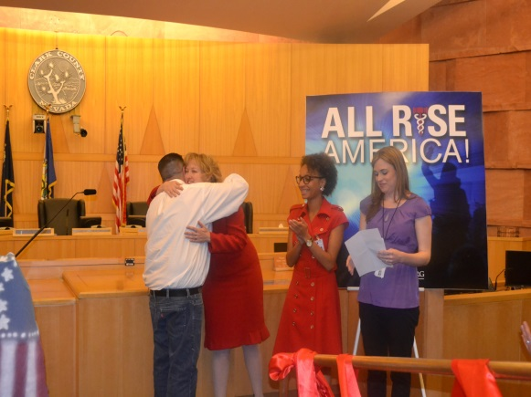
The Verdict Is In
Specialty Courts
Provide more HUMANE + Cost Effective Justice
Effective alternative to incarceration
Specialty Courts WORK
Better than jail or prison
Better than probation + treatment alone
Specialty Courts are more effective than any other proven criminal justice strategy.
NADCP

