Slide 1
Update on Prescription Drug Abuse and Overdose Data
Julia Peek, MHA
Deputy Administrator
Community Services
Nevada Division of Public and Behavioral Health

Slide 2
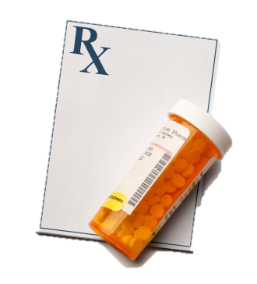
Overview
Prescribing Patterns and Prescriptions
Misuse
Overdose
Hospitalizations

Slide 3
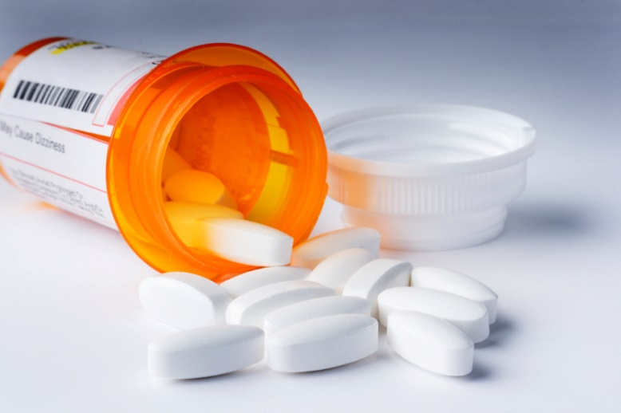
Prescribing Patterns

Slide 4
Prescribing Patterns
An estimated 1 out of 5 patients with non-cancer pain or pain-related diagnoses are prescribed opioids in office-based settings.
From 2007 – 2012, the rate of opioid prescribing has steadily increased among specialists more likely to manage acute and chronic pain.
Centers for Disease Control and Prevention 2016

Slide 5
Prescribing Patterns
Prescribing rates are highest among pain medicine (49%), surgery (37%), and physical medicine/rehabilitation (36%).
However, primary care providers account for about half of opioid pain relievers dispensed.
Centers for Disease Control and Prevention 2016

Slide 6
Prescribing Patterns
Prescription opioid use varies according to age, gender, and ethnicity:
Older adults (aged 40 years and older) are more likely to use prescription opioids than adults aged 20 – 39.
Women are more likely to use prescription opioids than men.
Non-Hispanic whites are more likely to use prescription opioids than Hispanics. There are no significant differences in prescription opioid use between non-Hispanic whites and non-Hispanic blacks.
Centers for Disease Control and Prevention 2016

Slide 7
Nevada compared to the nation
Nevada physicians write 94 painkiller prescriptions for every 100 Nevada residents

Slide 9
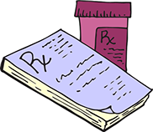
Nevada Prescription Monitoring Program (PMP)
From July 1, 2014 to June 30, 2015:
5,215,659 prescriptions for controlled substances were filled
362,635 queries performed by physicians (MDs, DOs)

Slide 10
PMP Prescriptions, 2015

Slide 11
PMP Quantity Dispensed, 2015

Slide 12
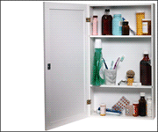
Misuse

Slide 13
Access to Opioids
Most people who abuse prescription opioids get them for free from a friend or relative.
Those who are at highest risk of overdose (using prescription opioids non-medically 200 or more days a year) get them in ways that are different from those who use them less frequently.
These people get opioids using their own prescriptions (27 percent), from friends or relatives for free (26 percent), buying from friends or relatives (23 percent), or buying from a drug dealer (15 percent).
Those at highest risk of overdose are about four times more likely than the average user to buy the drugs from a dealer or other stranger.
Centers for Disease Control and Prevention 2016

Slide 14
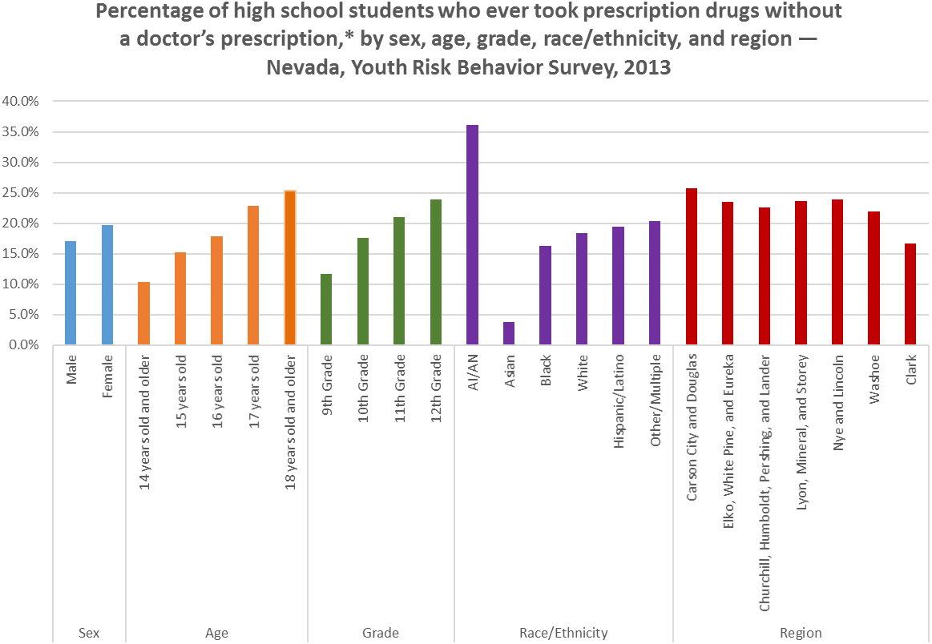

Slide 15
Percentage of high school students who ever took prescription drugs without a doctor’s prescription – Nevada High School Youth Risk Behavior Survey, 2013-2015.

Slide 16
Percentage of high school students who currently take prescription drugs without a doctor’s prescription – Nevada High School Youth Risk Behavior Survey, 2015.

Slide 17
Percentage of middle school students who ever took prescription drugs without a doctor’s prescription – Nevada Middle School Youth Risk Behavior Survey, 2015.

Slide 18
Percentage of middle school students who currently take prescription drugs without a doctor’s prescription – Nevada Middle School Youth Risk Behavior Survey, 2015.

Slide 19
Overdose Deaths
“Deaths from overdoses are reaching levels similar to the HIV epidemic at its peak.” - Robert Anderson, the CDC’s chief of mortality statistics

Slide 20
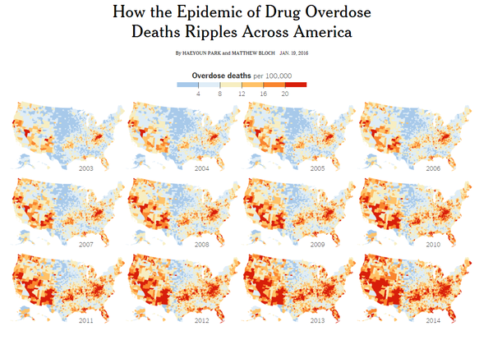
Overdose Deaths
New York Times, 2016

Slide 21
Overdose Deaths, 2014

Slide 22
Opioid Overdose
The most common drugs involved in
prescription opioid overdose deaths include:
Methadone
Oxycodone (such as OxyContin®)
Hydrocodone (such as Vicodin®)3
Among those who died from prescription opioid overdose between 1999 and 2014:
Overdose rates were highest among people aged 25 to 54 years.
Overdose rates were higher among non-Hispanic whites and American Indian or Alaskan Natives, compared to non-Hispanic blacks and Hispanics.
Men were more likely to die from overdose, but the mortality gap between men and women is closing.4
Centers for Disease Control and Prevention, 2016

Slide 23
Progress in Nevada
The age-adjusted rates of drug overdose deaths have increased by 6.5% in the United States between 2013 and 2014.
Only 10 states experienced a decrease in that time period
Nevada (-12.8%) was second only to Montana (-14.5%) in the states with the largest percentage decrease in deaths
Centers for Disease Control and Prevention, 2016

Slide 24
Overdose Deaths Related to Opiates, Nevada Residents
The following axis Codes are included in these data:
T40.1 Heroin
T40.2 Opioid Analgesics
T40.3 Opioid Analgesics
T40.4 Opioid Analgesics
T40.6 Other and unspecified opioids

Slide 25
Hospitalizations

Slide 26
Other Adverse Outcomes
Overdose is not the only risk related to prescription opioids. Misuse, abuse, and opioid use disorder (addiction) are also potential dangers.
In 2014, almost 2 million Americans abused or were dependent on prescription opioids.
As many as 1 in 4 people who receive prescription opioids long term for noncancerous pain in primary care settings struggles with addiction.
Every day, over 1,000 people are treated in emergency departments for misusing prescription opioids.
Centers for Disease Control and Prevention, 2016

Slide 27
Hospital Data Related to Opiate Dependence, Nevada Residents
The following ICD-9 Codes are included in these data:
304.00 Opioid type dependence, unspecified
304.01 Opioid type dependence, continuous
304.02 Opioid type dependence, episodic
304.03 Opioid type dependence, in remission
304.70 Combinations of opioid type drug with any other drug dependence, unspecified
304.71 Combinations of opioid type drug with any other drug dependence, continuous
304.72 Combinations of opioid type drug with any other drug dependence, episodic
304.73 Combinations of opioid type drug with any other drug dependence, in remission

Slide 32
Healthcare Costs
Hospitals charged almost
$15 billion
in 2012 for opioid-related inpatient care — more than double what they billed in 2002, even after accounting for inflation. And many were uninsured or on Medicaid, the federal-state health insurance program for low-income people.
Kaiser Health News, May 2016

Slide 33
Future Data Projects
Greater analysis of PMP data
Prescribing patterns (prescriber and patients)
As it related to hospitalizations and overdose
Greater breakdown of factors related to overdose and hospitalizations
Target prevention and treatment efforts
Law enforcement data sharing
Tracking of naloxone/narcan

Slide 34
Contact Information
Julia Peek, MHA
Nevada Division of Public and Behavioral Health
775-684-4192
jpeek@health.nv.gov

