Slide 1
Opioid use, dependence and Clinical Interventions
June 21, 2016 | Governor’s Planning Meeting
Reka Danko, M.D.
Chief Medical Officer|Director of MAT program, Northern Nevada HOPES
Hospitalist, Saint Mary’s Medical Center|Rosewood Rehabilitation
Assistant Clinical Professor, University of Nevada School of Medicine
580 W 5th St | Reno, NV 89503 | 775.786.4673 | nnhopes.org

Slide 2
No disclosures to report
This presentation outlines possible options for patients and does not favor any specific treatment plan
Presenter and all places of employment do NOT receive any financial or other incentives to prescribe any specific medications or promote any specific treatment programs

Slide 3
Opioids
Compounds such as oxycodone,
hydrocodone, morphine, fentanyl,
heroin and others
Opioids interact with opioid receptors on nerve cells in the brain and nervous system to produce pleasurable effects and relieve pain
Opioid
opioid
OPIOID RECEPTOR
Opioid receptor
Activation of receptor

Slide 4
Physiology and potential problems
Physical dependence -normal adaptations to exposure of drug creating a physiological reliance on the drug
Addiction -a primary, chronic and relapsing brain disease characterized by an individual pathologically pursuing reward
Overdose by respiratory depression (slowed breathing) which may cause death
Tolerance -need for higher doses to achieve pain relief or euphoric response
Withdrawal – wide range of symptoms that occur after stopping or reducing opioids
Opioid induced hyperalgesia (OIH) – paradoxical worsening of pain despite aggressive opioid therapy
Long term changes to the brain in decision making and behavior regulation

Slide 5
Defining opioid use disorder
Problematic pattern of opioid use leading to clinically significant impairment or distress, manifested by at least 2 of the following, occurring within a 12-month period:
Opioids taken in larger amounts or longer period than intended.
Persistent desire or unsuccessful efforts to cut down.
Time spent in activities necessary to obtain the opioid or use the opioid.
Craving or urge to use opioids.
Opioid use resulting in a failure to fulfill obligations at work, school, or home.
Continued opioid use despite having recurrent social or interpersonal problems caused by effects of opioids.
Social, occupational, or recreational activities are given up because of use.
Recurrent opioid use in situations in which it is physically hazardous.
Continued opioid use despite knowledge of having a persistent or recurrent physical or psychological problem that is due to opioids.
Tolerance, as defined by either (a) need for markedly increased amounts of opioids to achieve desired effect or (b) diminished effect with continued use of the same amount of opioid.
Withdrawal, as manifested by either (a) opioid withdrawal syndrome or (b) opioids taken to relieve withdrawal symptoms.
DSM - 5

Slide 6
Treatment Paradigm
Prescribers required to treat pain:
1995 – American Pain Society set guidelines for treating pain
1999 – Pain introduced as the 5th vital sign – making pain control as important as blood pressure, heart rate, temperature and respiratory rate
2001 – national standards released to treat pain endorsed by Joint Commission

Slide 7
The problem with opioids: different than other medications
Pain is subjective – no data to measure outcomes
Changes in regimen cannot be done quickly due to physiologic responses and complexity of involved systems
Used across various practice specialties
Opioids do not have a maximum daily dose as most other medications do
Opioid Induced Hyperalgesia = ongoing or worsening pain

Slide 8
2016 – Changing Treatment
Recognition of national epidemic
Opioid medications have high risk in short and long term use
CDC recommendations released March 2016 to guide prescribing of opioids outside of active cancer treatment, palliative care, and end-of-life treatment
  Nonpharmacologic therapy and nonopioid pharmacologic therapy are preferred for chronic pain; providers should only consider adding opioid therapy if expected benefits for both pain and function outweigh risks

Slide 9
New CDC guidelines
When considering long-term opioid therapy:
  Set realistic goals for pain and function based on diagnosis
  Check that non-opioid therapies tried and optimized
  Discuss benefits and risks (i.e. addiction, overdose) with patient
  Evaluate risk of harm or misuse
    Discuss risk factors with patient
    Check prescription drug monitoring program (PDMP) data
    Check urine drug screen
  Set criteria for stopping or continuing opioids
  Assess baseline pain and function (i.e. PEG scale)
  Schedule initial reassessment within 1- 4 weeks
  Prescribe short-acting opioids using lowest dosage on product labeling
  Match duration to scheduled reassessment

Slide 10
The leap from guidelines to practice
Non-opioid modalities often not covered by insurance/costly
Standardizing prescribing practices using subjective measures
Patient satisfaction scores driving best practices and reimbursement
Quality measures are based on pain control
Many criteria to accomplish as patient visits are getting shorter
PMP limitations - access to California, data input, time requirement
Many patients already have dependence, addiction, tolerance and hyperalgesia at time new guidelines are released

Slide 11
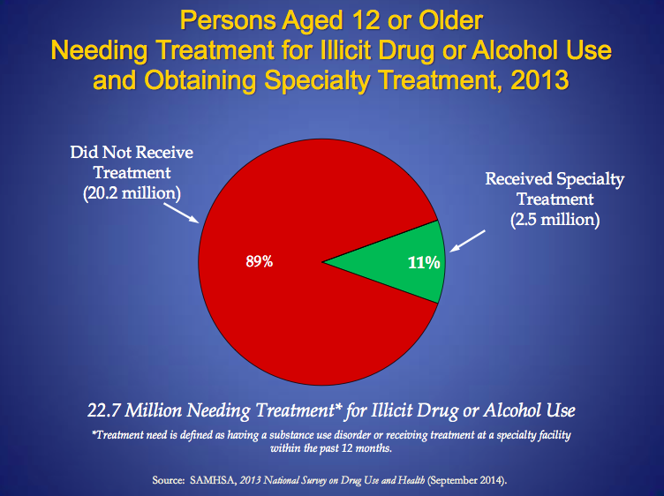
Clinical treatments
Overdose prevention and education
Access to treatment programs
Support for patients and providers

Slide 12
Overdose treatment
  Naloxone – short acting medication to remove opioid from opioid receptor
opioid
opioid
naloxone
Opioid receptor
Receptor activated
Increase access to naloxone
Educate patients and prescribers

Slide 13
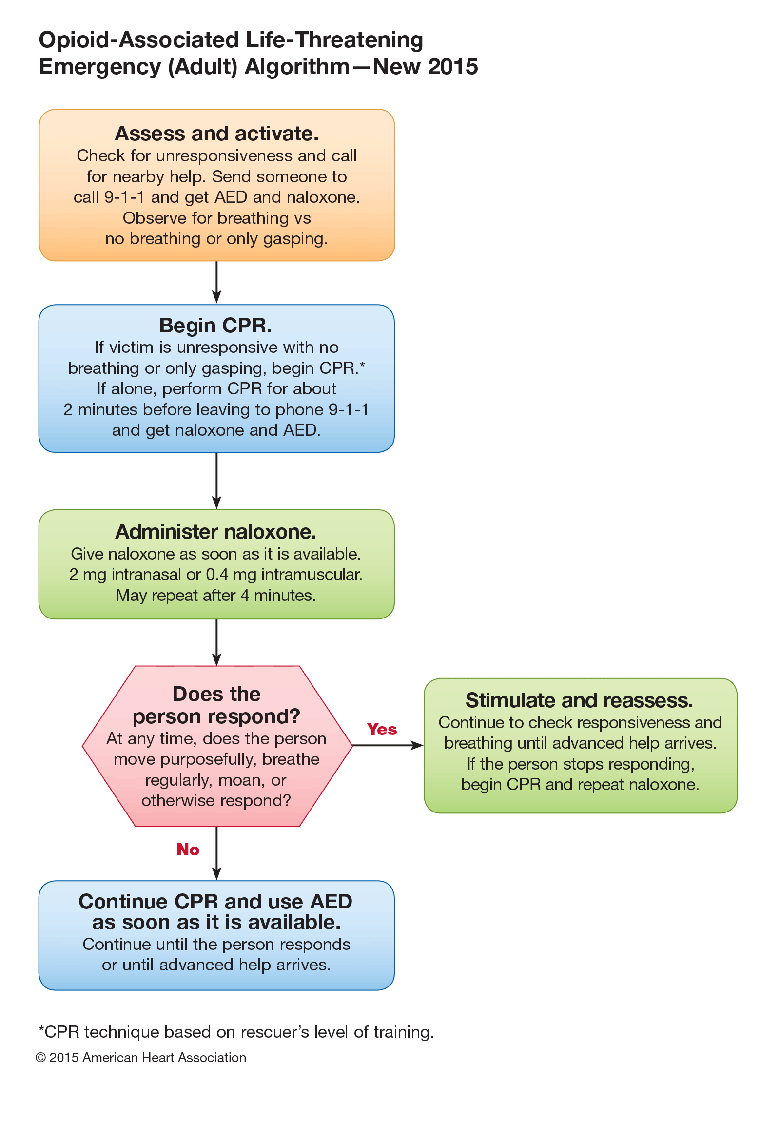
Opioid overdose algorithm
Call 911
Start CPR
Administer naloxone
If no response, continue CPR

Slide 14
Treatment of opioid use disorder
Need for variety of treatment options
Addiction is a chronic and relapsing disease - individual assessment to find the best treatment options for each patient
Bio-psycho-social model considerations – physical, emotional, mental health

Slide 15
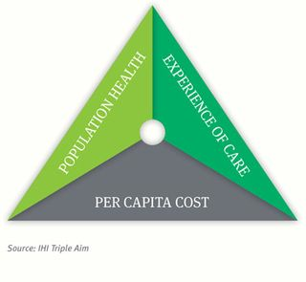
Medication Assisted Treatment
Include psychosocial treatment
Support for the providers “quadruple aim”
Quality – evidence based practices
Access to programs
Cost effective strategy
Triple Aim

Slide 16
Medications for Opioid Use Disorder
Maintenance therapy
3 FDA approved medications
  Methadone
  Buprenorphine
  Naltrexone
Detox – management of withdrawal
  Inpatient vs. outpatient

Slide 17
At the receptor level
opioid
opioid
methadone
buprenorphine
naltrexone
Opioid receptor
Opioid receptor
Opioid receptor
naloxone
AGONIST: long acting activation of receptor
PARTIAL AGONIST:
partial activation, partial blockade
ANTAGONIST:
no activation, blocks opioids

Slide 18
Methadone (schedule II)
Regulation: strict federal guidelines dictate eligibility for methadone maintenance
Benefit: prevents withdrawal symptoms, reduces cravings, reduces euphoria of subsequent opioid use, efficacy in opioid use disorder
Risk: possible overdose risk, misuse, hyperalgesia, cardiac arrhythmias, dependence
methadone
Opioid receptor
naloxone
AGONIST: long acting activation of receptor

Slide 19
Buprenorphine (schedule III)
Regulation: certified and specially trained clinician; patient limits in treatment
Benefits: Detox and maintenance therapy, craving reduction, combined with naloxone to prevent misuse, good efficacy in opioid use disorder
daily oral or (new) long-acting implant
opioid
Risks: may induce withdrawal if other opioids in system, misuse risk, street value due to withdrawal aid, dependence
buprenorphine
Opioid receptor
naloxone
PARTIAL AGONIST:
partial activation, partial blockade

Slide 20
Naltrexone (prescription)
Limitations: requires completed withdrawal from opioids (will precipitate withdrawal if taken with opioids in the system); requires highly motivated patient; cannot aid with detox
Benefits: prevents opioid intoxication and dependence, reinforces abstinence, efficacy in opioid and alcohol use, no addiction potential
Oral daily dose vs. long acting injection
Risks: may have increase risk of death from overdose due to decrease in tolerance with receptor blockade (depending upon dose of opioid used in relapse)
opioid
buprenorphine
naltrexone
Opioid receptor
naloxone
ANTAGONIST:
no activation, blocks opioids

Slide 21
Other Considerations
MAT maintenance produces better outcomes than detox alone
  50% abstinent at the end of active treatment vs. 8% when medication is withdrawn
Need for resources – integrated care model, community involvement, cost, environmental support (housing, transportation), coexisting medical/behavioral conditions
Extrinsic motivators – Criminal Justice System
  Improved outcomes
  Weiss RD, Potter JS, Griffin ML, McHugh RK, Haller D, Jacobs P, Gardin J 2nd, Fischer D, Rosen KD. Adjunctive Counseling During Brief and Extended Buprenorphine-Naloxone Treatment for Prescription Opioid Dependence: A 2-Phase Randomized Controlled Trial Published in final edited form as: Arch Gen Psychiatry. 2011 December; 68(12): 1238–1246.

Slide 22
Mismatch between regulation and practice
Prescribing Opioids | Prescribing Medication Assisted Treatment
Requires active practice license and DEA license | Strict regulation for treatment programs/ additional licensing requirements (methadone, buprenorphine)
No patient limits | Limited # of patients per prescriber (buprenorphine)
No additional training required to prescribe opioids (often schedule II) | Training and certification required to prescribe buprenorphine (schedule III)
Many prescribers | Limited treatment programs and prescribers
Guidelines mandating pain control, driving of satisfaction scores and reimbursements | No guidelines to mandate awareness or treatment of dependence and addiction and poor access to/coverage of nonopioid alternatives
Covered by most insurance plans | Often requires cash payment or extensive prior authorizations

Slide 23
Future considerations
Education opportunities
Overdose and use prevention
Increase in treatment programs
Changes to satisfaction measures/quality measures which are driving practices
Coverage for first-line treatments without barriers (regulations and prior authorizations)
Due to prior evidence supporting opioid prescribing – process will require safe and effective transition for patients and prescribers

Slide 24
References
Centers for Disease Control and Prevention
  https://www.cdc.gov/mmwr/volumes/65/rr/rr6501e1.htm
  www.cdc.gov/drugoverdose/prescribing/guideline.html
National Institutes of Health
  https://www.nih.gov/news-events/news-releases/hhs-leaders-call-expanded-use-medications-combat-opioid-overdose-epidemic
American Society of Addiction Medicine
  www.asam.org/quality-practice/practice-resources/treatment
  The ASAM Criteria; Treatment Criteria for Addictive, Substance-Related, and Co-Occurring Conditions, Third Edition.
Substance Abuse and Mental Health Services Administration
  www.samhsa.gov/treatment/substance-use-disorders
  www.samhsa.gov/medication-assisted-treatment
American Heart Association
  eccguidelines.heart.org/wp-content/uploads/2015/10/2015-AHA-Guidelines-Highlights-English.pdf
Diagnostic and Statistical Manual of Mental Disorders (DSM-V)
American Pain Society
  americanpainsociety.org/education/guidelines/overview
Drug Enforcement Administration, Office of Diversion Control
  www.deadiversion.usdoj.gov

Slide 25
Thank you
Contact:
Reka Danko, M.D.
Northern Nevada HOPES
580 W. 5th Street
Reno NV, 89503
(775) 525-4316 | rdanko@nnhopes.org

