Slide 1
Mental Illness and the Criminal Justice System in Nevada
Nevada Division of Public and Behavioral Health
March 2013
Christopher Moore, MPH Candidate
Southern Nevada Adult Mental Health Services
Jay Kvam, MSPH, State Biostatistician
Nevada Division of Public and Behavioral Health
Ihsan Azzam, MD, PhD, State Epidemiologist
Nevada Division of Public and Behavioral Health
Pamela Graber, MA, Public Information Officer
Office of Public Health Informatics and Epidemiology
Julia Peek, MHA, Manager
Office of Public Health Informatics and Epidemiology

Slide 2
Introduction
Incarceration is increasingly being used to deal with mentally ill individuals
Criminalization hypothesis: Inappropriate use of arrest by law enforcement as a means of dealing with mentally-disordered individuals
  Deinstitutionalization
  Reductions in mental health spending
  Co-occurring diagnoses
  Socioeconomic and demographic factors

Slide 3
Introduction
Three times as many individuals with serious mental illness (SMI) are incarcerated than receiving hospital-based treatment.
In the last 30 years, the number of inmates with SMI has tripled.
7-16% of inmates have a mental illness.

Slide 4
Objective
Understand the prevalence and demographic distribution of mental illness in the jails of the three most populous counties in Nevada.
Consider policies and programs that have been, or could be, implemented to reduce the burden the criminalization of mental illness has placed on Nevada jails, and provide a better and more appropriate standard of care.

Slide 5
Methods
Descriptive Statistics: 2011 Division of Mental Health and Developmental Services (MHDS) data were cross-matched with data from three Nevada jails:
  Clark County Detention Center (CCDC)
  Washoe County Detention Facility (WCDF)
  Carson City Jail (CCJ)
Population data from the US Census Bureau were utilized for comparisons with countywide rates for demographic variables
Analytical Statistics: Correlation between number of clinic visits/hospital admissions and frequency of incarceration were analyzed using Spearman’s rank correlation

Slide 6
Results

Slide 20
Table 1. Correlation Between Number of Hospitalizations or Clinic Visits and Number of Detentions in 2011.
 | CCDC | WCDF | CCJ
MHDS Hospital Admissions and Detentions | rs[487] = .095, p < .05 | rs[105] = .214, p < .05 | Non-significant
MHDS Outpatient Clinic Visits and Detention | rs[2138] = .059, p < .01 | rs[910] = .147, p < .05 | Non-significant
*Correlations calculated using the Spearman’s Rank Correlation Coefficient in SPSS (version 20).

Slide 21
Table 2. Legal Holds Placed by the LVMPD and Detainment by CCDC, 2011-2012.
 | 2011 | 2012
Legal Holds | 5,989 | 6,185
CCDC Detainees with Mental Illness | 5,703 | Not Available
Note: Total may include individuals counted more than once due to multiple legal holds. 248 individuals were placed on legal holds from CCDC

Slide 22
Criminalization of Mental Illness

Slide 24
Criminalization of Mental Illness
Financial incentive for criminalization
2001 Report by the Bureau of Justice Statistics
  Annual operating costs per prisoner in Nevada were $48.14 per day
VERA Institute of Justice study
  States spent an average of $76.03 per inmate per day in 2010
  Nevada prison expenditures had increased by 9.39 percent between 2006 and 2010

Slide 25
Table 3. Comparison of Treatment and Incarceration Costs, FY 2012
 | NNAMHS | SNAMHS | LVMPD
Admission/ Incarceration (Per bed day) | $1383.71 | $656.10 | $144.00
OP Clinic Visit | $197.84 | $166.54 | N/A

Slide 26
Potential Solutions
Expansion of existing jail diversion programs, such as Mental Health Court, to include service provision for more mentally-disordered individuals.
Development of government and community partnerships to provide seriously mentally ill individuals with case management services and the social supports necessary to successfully transition from incarceration to community living.

Slide 27
Mental Health Court (MHC)
Community-based program involving multiple Nevada government and local partnerships
Diverts non-violent offenders with mental illness into treatment programs
Goal: Reduce or eliminate offender recidivism by treating mental illness

Slide 30
2013 Legislative Session: Assembly Bill 297
Authorizes involuntary court-ordered admission of certain adults with mental illness to programs of outpatient services.
  History of treatment noncompliance
  Able to live safely in the community
  Admission necessary to prevent further disability likely to result in harm to self or others
  Limited ability to comply voluntarily with treatment
  Least restrictive treatment option

Slide 31
Seamless Transitions to Outpatient Services
Rawson Neal Behavioral Health Center
  Seamless transition to outpatient care
  Intensive case management services
  Housing provision
    Dependent on strengthening partnerships between Mental Health and Criminal Justice professionals
Drop-in Center
  Integration into the community
  Peer support
  Vocational training
  Community resource and service access

Slide 32
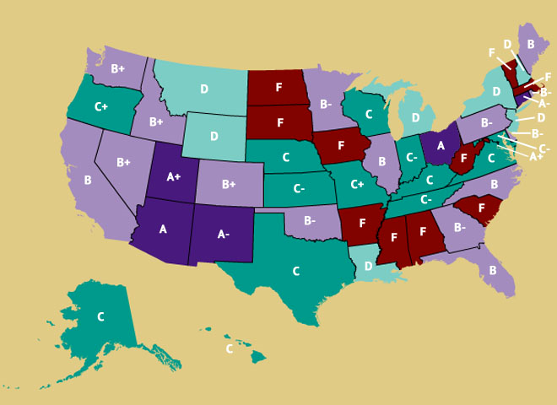
Treatment Advocacy Center Study
Figure 20. Prevalence of Mental Health Diversion Practices: A Survey of the States (2013)

Slide 33
Table 4. Nevada’s Grade for Mental Health Diversion Practices
Percentage of population served by a Mental Health Court | Percentage of population served by Crisis Intervention Team | Average Percentage | Grade
88% | 37% | 63% | B+

Slide 34
Conclusions
Criminalization of mental illness has placed a high burden on the criminal justice system in Nevada
An approach involving multiple programs ranging in levels of intensity is needed to reduce this burden
Longitudinal data need to be collected to evaluate the effectiveness of each of these programs

Slide 35
Limitations
Cross-matched data does not account for those individuals utilizing private services
  Underrepresentation of mental illness in jails
Misclassification
  Prevalence rates sometimes total over 100 percent
Individuals may not be current utilizers of psychiatric services
MHDS clients may have been detained elsewhere
  Actual prevalence of incarceration may be higher
  Study of incarceration statewide is recommended

Slide 36
Contact Information
For more information, contact:
  Christopher Moore
  Southern Nevada Adult Mental Health Services
    Telephone: (702)486-6447
    Email: chrismoore@health.nv.gov

Slide 37
Acknowledgements
The CCDC results of this study have also been presented in a Nevada Division of Public and Behavioral Health Report:
  Moore, C., Kvam, J. Azzam, I., Graber, P., & Peek, J. (2013, March). Mental Illness and the Criminal Justice System: Clark County, Nevada. http://health.nv.gov/publications.htm
The authors thank Jodie Gerson, Sharon Dollarhide, Kurt Green, and Adrian Ramirez for providing MHDS data. The authors also thank Dr. Patricia Cruz for providing guidance in the development of this presentation.

Slide 38
Works Cited
Guerino, P. H., Harrison, P.M, & Sabol, W.J. (2011, December). Prisoners in 2010. Retrieved 15 2013, March, from Bureau of Justice Statistics: http://bjs.gov/content/pub/pdf/p10.pdf
McKnight, T. (2012). Nevada's Division of Mental Health and Developmental Services 2012 Needs Assessment. State of Nevada Division of Mental Health and Developmental Services.
Osterweil, N. (2011, 17 November). Severe Mental Disorders Highly Prevalent in Jails, Prisons. Retrieved March 14, 2013, from Clinical Psychiatry News: http://www.clinicalpsychiatrynews.com/news/more-top-news/single-view/severe-mental-disorders-highly-prevalent-in-jails-prisons/a25755da9f.html.
Steadman, H.J., Osher, F.C., Robbins, P.C., Case, B., Samuels, S. (2009), “Prevalence of serious mental illness among jail inmates. Psychiatric Services;60:761–765. doi: 10.1176/appi.ps.60.6.761.
Stephan, J. (2004, June). State Prison Expenditures, 2001. Retrieved March 17, 2013, from Bureau of Justice Statistics: http://bjs.gov/content/pub/pdf/spe01.pdf.
Subramanian, R. & Tublitz, R. (2012, September). Realigning Justice Resources: A Review of Population and Spending Shifts in Prison and Community Corrections. Retrieved March 17, 2013, from VERA Institute of Justice: http://www.vera.org/files/Full%20Report.pdf.
Teplin, L.A. (1990). The prevalence of severe mental disorder among male urban jail detainees: comparison with the Epidemiologic Catchment Area Program. Am J Public Health. 80(6), 663–669.
Torrey, E.F., Kennard, A.D., Eslinger, D., Lamb, R., & Pavle, J. (2010, May). More Mentally Ill Persons are in Jails and Prisons Than Hospitals: A Survey of the States. Retrieved from: http://www.treatmentadvocacycenter.org/storage/documents/final_jails_v_hospitals_study.pdf
United States Census Bureau. (2010). American Fact Finder: Clark County, Nevada Retrieved March 14, 2012, from United States Census Bureau: http://factfinder2.census.gov/faces/tableservices/jsf/pages/productview.xhtml?pid=DEC_10_DP_DPDP1.
YCharts. (2013). Nevada Unemployment Rate. Retrieved March 15, 2013, from YCharts: http://ycharts.com/indicators/nevada_unemployment_rate.

